Slide 1
DESIGN AND DEVELOPMENT OF AUTOMATED GATE SECURITY AND ACCESS CONTROL SYSTEM TECHNOLOGY FOR ENTERPRISES (FINAL PROJECT REVIEW)
Project Guide: Mr Zafar Ali Khan N, Assistant Professor and Program Chair, CSE

Slide 2
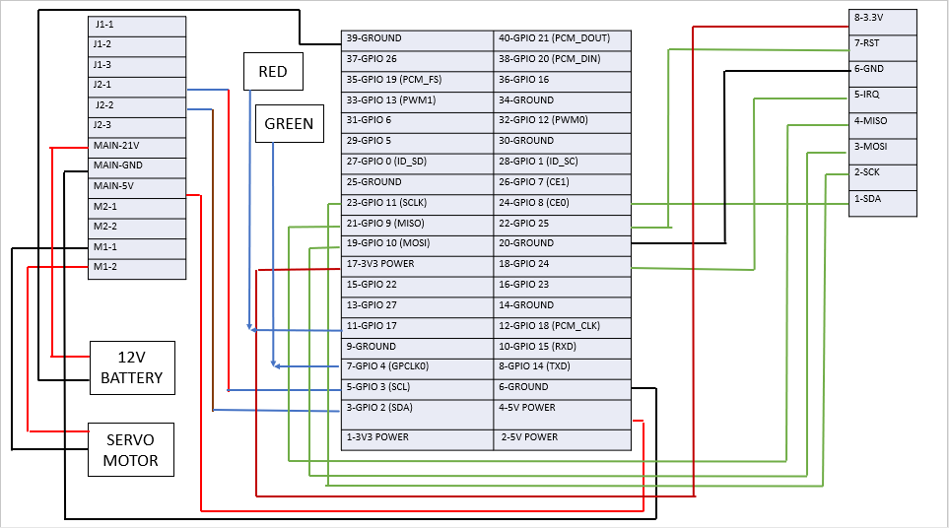
4.The Hardware Part

Slide 3
